Slide 1
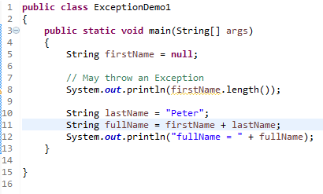
Java catch block
Problem without exception handling
Output
Exception occurred at line number 8,so rest of the code is not executed.
There can be 1000 lines of code after exception. So all the code after exception will not be executed.

Slide 2
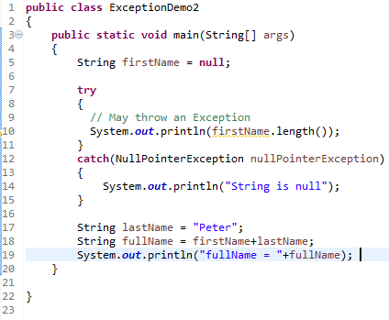

Java catch block
Solution by exception handling
Output
Exception occurred at line number 10 and we handled in catch block, So rest of the code is executed .

Slide 3
Java catch block
an object of Exception
class is thrown.
String firstName = null;
// May throw an Exception
System.out.println(firstName.length());
Exception object
no
isHandled?
yes
The JVM firstly checks whether the exception is handled or not. If exception is not handled, JVM provides a default exception handler that performs the following tasks:
Prints out exception description.
Prints out stack trace (Hierarchy of methods where the exception occurred).
Terminates the program.
If exception is handled by the application programmer, normal flow of the application is maintained i.e. rest of the code is executed.

